Slide 1
Value at Risk and Expected Shortfall
Chapter 11

Slide 2
The Question Being Asked in VaR
“What loss level is such that we are X% confident it will not be exceeded in N business days?”

Slide 3
VaR and Regulatory Capital
Regulators have traditionally used VaR to calculate the capital they require banks to keep, but have recently switched to ES for market risks
The market-risk capital has been based on a 10-day VaR estimated where the confidence level is 99%
Credit risk and operational risk capital are based on a one-year 99.9% VaR

Slide 4
Advantages of VaR
It captures an important aspect of risk
in a single number
It is easy to understand
It asks the simple question: “How bad can things get?”

Slide 5
Example 11.1
The gain from a portfolio during six month is normally distributed with mean $2 million and standard deviation $10 million
The 1% point of the distribution of gains is 2−2.33×10 or − $21.3 million
The VaR for the portfolio with a six month time horizon and a 99% confidence level is $21.3 million.

Slide 6
Example 11.2
All outcomes between a loss of $50 million and a gain of $50 million are equally likely for a one-year project
The VaR for a one-year time horizon and a 99% confidence level is $49 million

Slide 7
Examples 11.3 and 11.4
A one-year project has a 98% chance of leading to a gain of $2 million, a 1.5% chance of a loss of $4 million, and a 0.5% chance of a loss of $10 million
The VaR with a 99% confidence level is $4 million
What if the confidence level is 99.9%?
What if it is 99.5%?

Slide 8
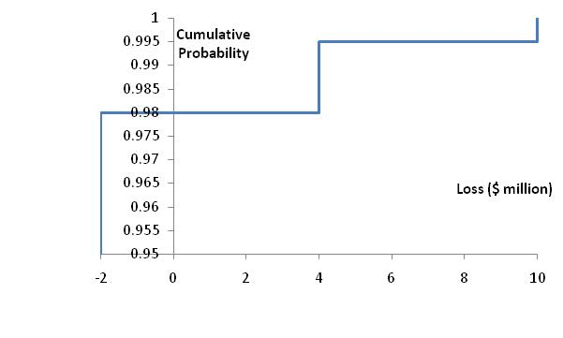
Cumulative Loss Distribution for Examples 11.3 and 11.4 (Figure 11.3)

Slide 9
VaR vs. Expected Shortfall
VaR is the loss level that will not be exceeded with a specified probability
Expected shortfall (ES) is the expected loss given that the loss is greater than the VaR level (also called C-VaR and Tail Loss)
Regulators have moved from using VaR to using ES for determining market risk capital
Two portfolios with the same VaR can have very different expected shortfalls

Slide 10
Distributions with the Same VaR but Different Expected Shortfalls
VaR
VaR

Slide 11
Coherent Risk Measures
Define a coherent risk measure as the amount of cash that has to be added to a portfolio to make its risk acceptable
Properties of coherent risk measure
  If one portfolio always produces a worse outcome than another its risk measure should be greater
  If we add an amount of cash K to a portfolio its risk measure should go down by K
  Changing the size of a portfolio by λ should result in the risk measure being multiplied by λ
  The risk measures for two portfolios after they have been merged should be no greater than the sum of their risk measures before they were merged

Slide 12
VaR vs Expected Shortfall
VaR satisfies the first three conditions but not the fourth one
ES satisfies all four conditions.

Slide 13
Example 11.5 and 11.7
Each of two independent projects has a probability 0.98 of a loss of $1 million and 0.02 probability of a loss of $10 million
What is the 97.5% VaR for each project?
What is the 97.5% expected shortfall for each project?
What is the 97.5% VaR for the portfolio?
What is the 97.5% expected shortfall for the portfolio?

Slide 14
Examples 11.6 and 11.8
A bank has two $10 million one-year loans. Possible outcomes are as follows
If a default occurs, losses between 0% and 100% are equally likely. If a loan does not default, a profit of 0.2 million is made.
What is the 99% VaR and expected shortfall of each project
What is the 99% VaR and expected shortfall for the portfolio
Outcome | Probability
Neither Loan Defaults | 97.5%
Loan 1 defaults, loan 2 does not default | 1.25%
Loan 2 defaults, loan 1 does not default | 1.25%
Both loans default | 0.00%

Slide 15
Spectral Risk Measures
A spectral risk measure assigns weights to quantiles of the loss distribution
VaR assigns all weight to Xth percentile of the loss distribution
Expected shortfall assigns equal weight to all percentiles greater than the Xth percentile
For a coherent risk measure weights must be a non-decreasing function of the percentiles

Slide 16
Normal Distribution Assumption
When losses (gains) are normally distributed with mean μ and standard deviation σ

Slide 17
Changing the Time Horizon
If losses in successive days are independent, normally distributed, and have a mean of zero

Slide 18
Extension
If there is autocorrelation ρ between the losses (gains) on successive days, we replace by
in these equations

Slide 19
Ratio of T-day VaR to 1-day VaR (Table 11.1)
 | T=1 | T=2 | T=5 | T=10 | T=50 | T=250
ρ=0 | 1.0 | 1.41 | 2.24 | 3.16 | 7.07 | 15.81
ρ=0.05 | 1.0 | 1.45 | 2.33 | 3.31 | 7.43 | 16.62
ρ=0.1 | 1.0 | 1.48 | 2.42 | 3.46 | 7.80 | 17.47
ρ=0.2 | 1.0 | 1.55 | 2.62 | 3.79 | 8.62 | 19.35

Slide 20
Choice of VaR Parameters
Time horizon should depend on how quickly portfolio can be unwound. Regulators are planning to move toward a system where ES is used and the time horizon depends on liquidity. (See Fundamental Review of the Trading Book)
Confidence level depends on objectives. Regulators have used 99% for market risk and 99.9% for credit/operational risk.
A bank wanting to maintain a AA credit rating might use confidence levels as high as 99.97% for internal calculations.

Slide 21
Aggregating VaRs
  An approximate approach that seems to works well is
  where VaR_{i} is the VaR for the ith segment, VaR_{total} is the total VaR, and ρ_{ij} is the coefficient of correlation between losses from the ith and jth segments

Slide 22
VaR Measures for a Portfolio where an amount x_{i} is invested in the ith component of the portfolio
Marginal VaR:
Incremental VaR: Incremental effect of the ith component on VaR
Component VaR:

Slide 23
Properties of Component VaR
The component VaR is approximately the same as the incremental VaR
The total VaR is the sum of the component VaR’s (Euler’s theorem)
The component VaR therefore provides a sensible way of allocating VaR to different activities

Slide 24
Back-testing
Back-testing a VaR calculation methodology involves looking at how often exceptions (loss > VaR) occur
Alternatives: a) compare VaR with actual change in portfolio value and b) compare VaR with change in portfolio value assuming no change in portfolio composition
Suppose that the theoretical probability of an exception is p (=1−X). The probability of m or more exceptions in n days is

Slide 25
Bunching
Bunching occurs when exceptions are not evenly spread throughout the back testing period
Statistical tests for bunching have been developed by Christoffersen

